Slide 1

Final Project
INFO7390 Advances Data Sci/Architecture SEC 02 - Fall 2017
Team Members :
Jaini Bhansali
Tushar Goel

Slide 2
Overview
In the era of e-commerce where we buy anything we wished for in a span of a click, groceries is the new product that can be bought with a mouse click. Companies like Amazon Fresh, InstaCart are utilizing this to deliver groceries at the user’s doorstep. Instacart, a grocery ordering and delivery app, aims to make it easy to fill your refrigerator and pantry with your personal favorites and staples when you need them. After selecting products through the Instacart app, personal shoppers review their order and do the in-store shopping and delivery for you.
This project would help us contribute to revolutionary concept of grocery shopping as it has been predicted that by the year 2025, grocery sales is going grab 20% of the market sales.

Slide 3
Goals
Improving Instacart’s ability to provide relevant products to user and increase the sales by recommending unexplored products by that user.
Provide Summary Metrics to Instacart Admin for analyzing the patterns by means of tableau dashboard and EDA.
InstaCart User: Improve a user’s shopping experience with recommendations based on the buying pattern.

Slide 4
Process Outline
Data Scrapping
2. Data Preprocessing
- Data Cleaning and Handle Missing Value Analysis
- Join the different csv’s to form a joint dataset
Exploratory Data Analysis
6. Study of Unsupervised approaches
Design a Data Pipeline and a feasible system to
implement this approach
8. Deploy the Model using Azure/AWS or another feasible approach
9. Build a web application to demonstrate Associations and recommendations

Slide 5
Framework Workflow

Slide 6
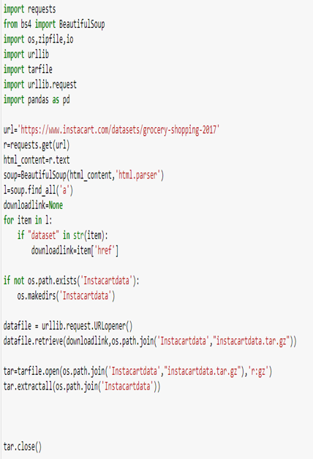
Scraping Data
Since, the data is publicly available we scraped the data from the instacart.com
The data set consists of list of prior orders of the user and the latest orders of the user. The orders miss details of the products names, departments and aisles. Hence, we have merged the data to get complete details of the prior orders and the latest orders.

Slide 7
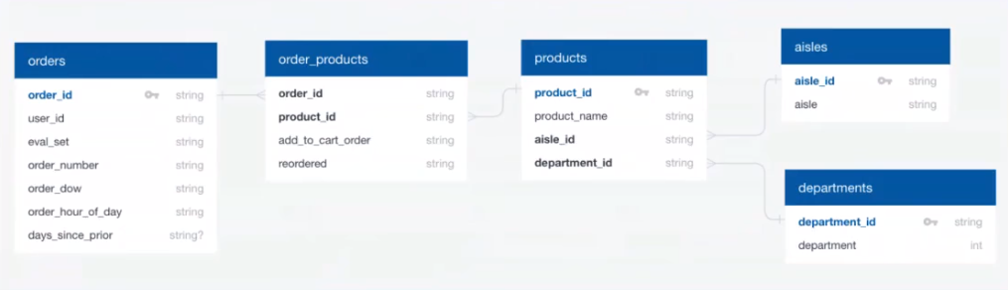
Relational View of the data
This screenshot gives us a view of how our data is related and hence helped us in merging and better in the understanding of the data

Slide 8
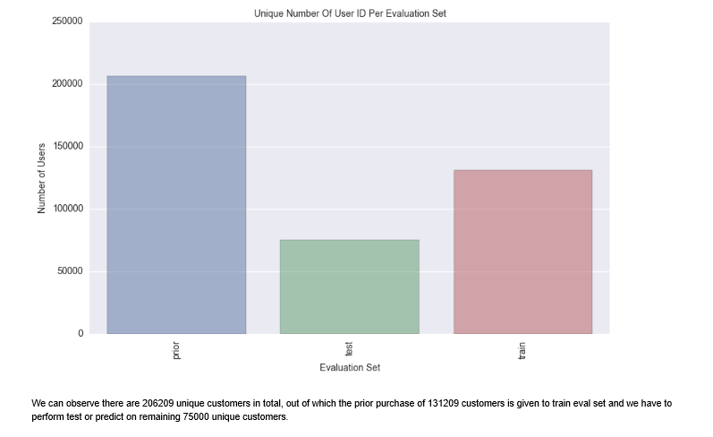
EDA and Summary Metrics
This graph gives us the unique user-id’s present on the basis of the evaluation sets and as we can see there are maximum unique values in the prior set vs the train and test set

Slide 9
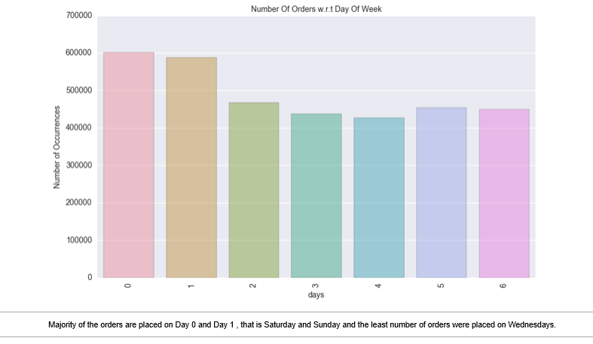
EDA and Summary Metrics
This Picture gives us the information on which days of the week people come and buy the most.
This helps us in predicting the stocks that need to be maintained by the company
As it can be clearly seen on Saturday and Sunday’s there is a spike in the number of orders

Slide 10
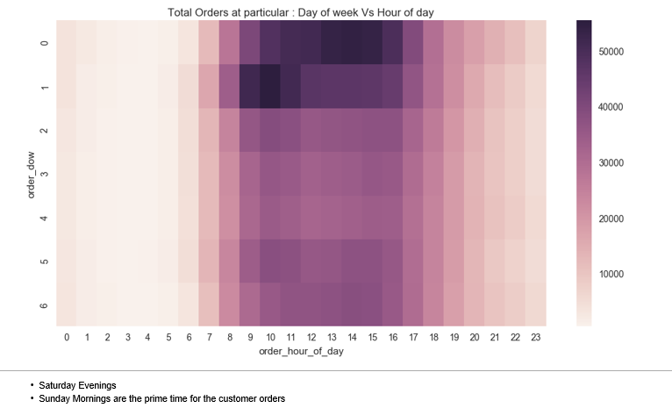
EDA and Summary Metrics
This HeatMap gives us the information on which days and which hours of the week people come and buy the most.
This helps us in predicting the stocks as well as need of having suppliers ready at that time
As it can be clearly seen on Saturday and Sunday’s between 8am to 4pm a lot of orders are places

Slide 11
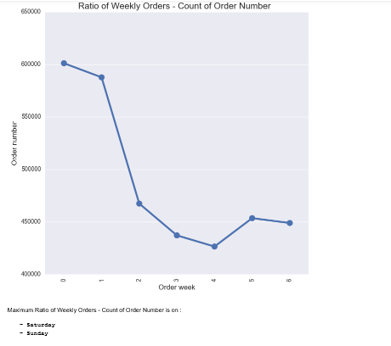
EDA and Summary Metrics
This graph gives us the information on the ratio of weekly orders w.r.t number of orders.
As it can be clearly seen on Saturday and Sunday’s there is a spike in the number of orders.

Slide 12
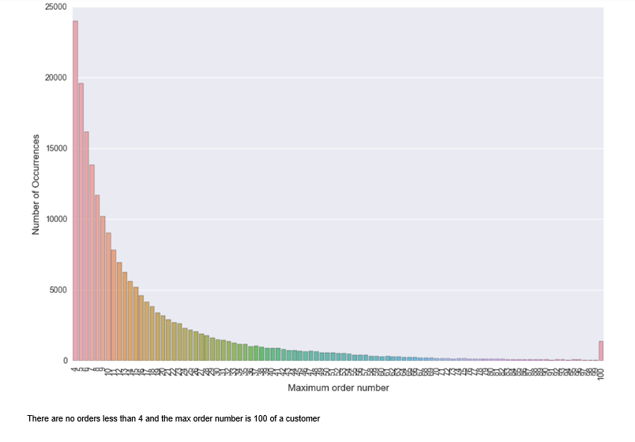
EDA and Summary Metrics
This graph gives us the information on how many order numbers are present for users
As it can be clearly seen the dataset ha most users with only four orders and as there are only few users with high on number of orders
This will help us tune our Sequential model’s parameters

Slide 13
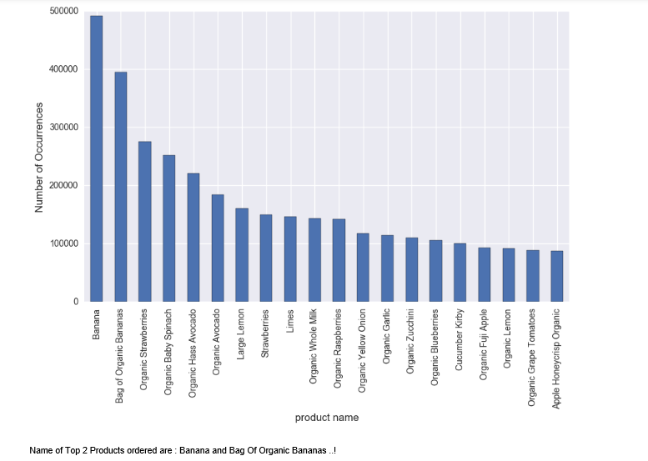
EDA and Summary Metrics
Name of Top 20 Products Ordered
This Graph gives us the information on the most popular items ordered
As it can be clearly seen bananas and bag of organic bananas are the most ordered products
Also most of the products ordered are organic, fruits or vegetables
This help us create a basic recommendation systems

Slide 14
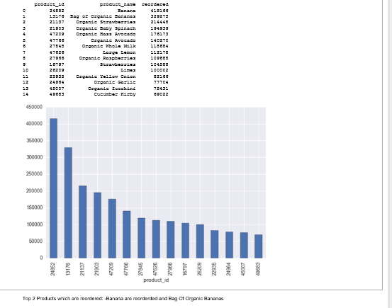
EDA and Summary Metrics
This Graph gives us the information on the most reordered product
As it can be clearly seen bananas and bag of organic bananas are the most ordered products
Also most of the products ordered are organic, fruits or vegetables
This help us create a basic recommendation systems

Slide 15
Basic Recommendation Models
For the project we decided on using some basic recommendation models apart from the predictions that we will provide.
Here is a list of all the basic models that we have made and will be using
Most Bought Product of all time
Most visited department
Most frequently bought products by the specific user
Most frequently bought products on that hour
Most frequently bought product on that day
Most frequently bought product on that hour of that day
Most Reordered product by that user

Slide 16
Recommendations
We have used Collaborative filtering recommendation systems that uses model based filtering wherein the features get converted into latent features.
We have deployed all the recommendation models on Azure and also did clustering on basis of department and deployed recommendation models for each of them.
We have used Apriori Algorithm to find associations between products and ran all the department clustered data on Apriori on Google Cloud Platform from where we extracted the csv’s which we used in our we application

Slide 17
Final Result
We have deployed the application on Google Cloud platform
Here is the link for the web application: http://35.190.167.191/
Workflow of the web application

Slide 18
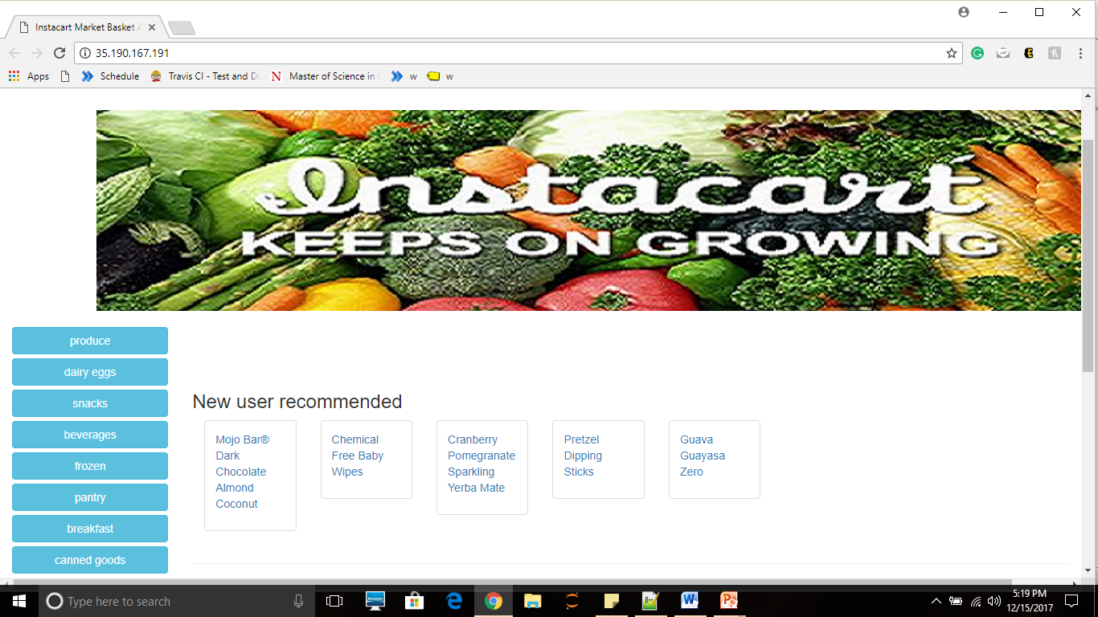
Application Screenshots
New User Page

Slide 19
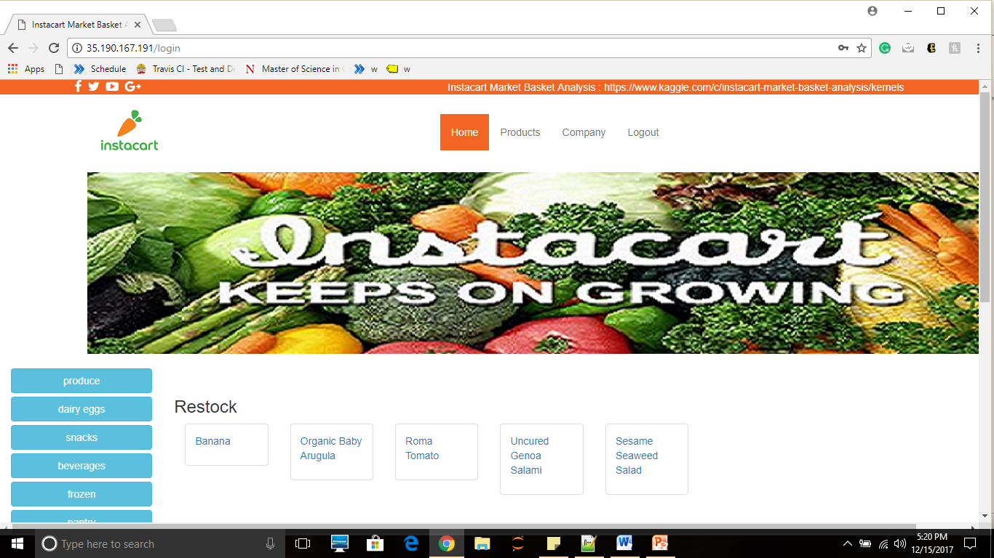
Application Screenshots
Old user page: please login using any userId with only integer value between 1-200000 example username: 100 pasword: anysdjisajdi

Slide 20
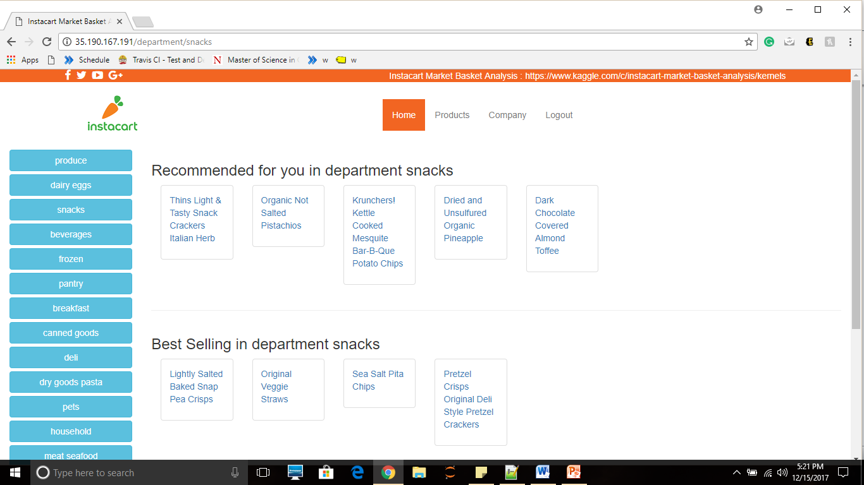
Application Screenshots
Department Page shows the results of recommendation in Departments

Slide 21
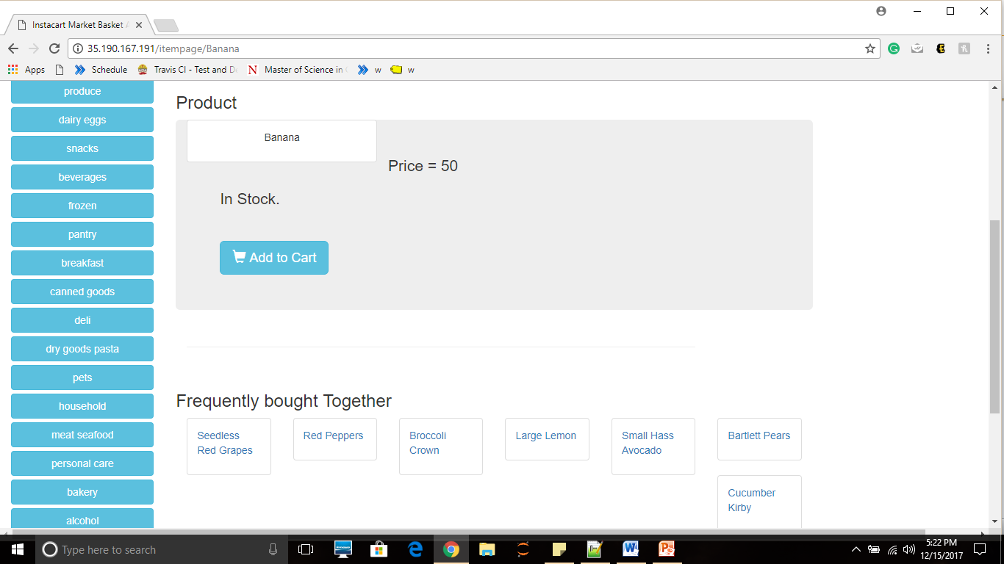
Application Screenshots
Item Page: here are the results of Apriori

Slide 22
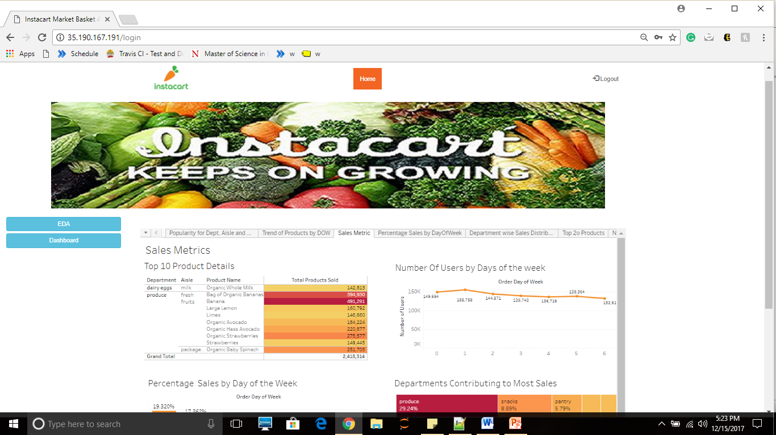
Application Screenshots
Admin Dashboard
Please note that to login as admin put username: Admin and Password:tushar
To See the tableau dashboard you need to login using tableau credentials that we will provide in the email since it is a free version we cannot overcome this

Slide 23
Work Division
Team Members:
Tushar Goel : EDA, Luigi Pipeline, WebScraping, Docker, Heuristics calculation, Feature Engineering, Recommendation Models, Web Development and Deployment, Dashboarding, Documentation
2. Jaini Bhansali: EDA, Merging Datasets, Heuristics, Feature Engineering, Web Development, Dashboarding, Apriori Implementation, Documentation

Slide 24


